Slide 1
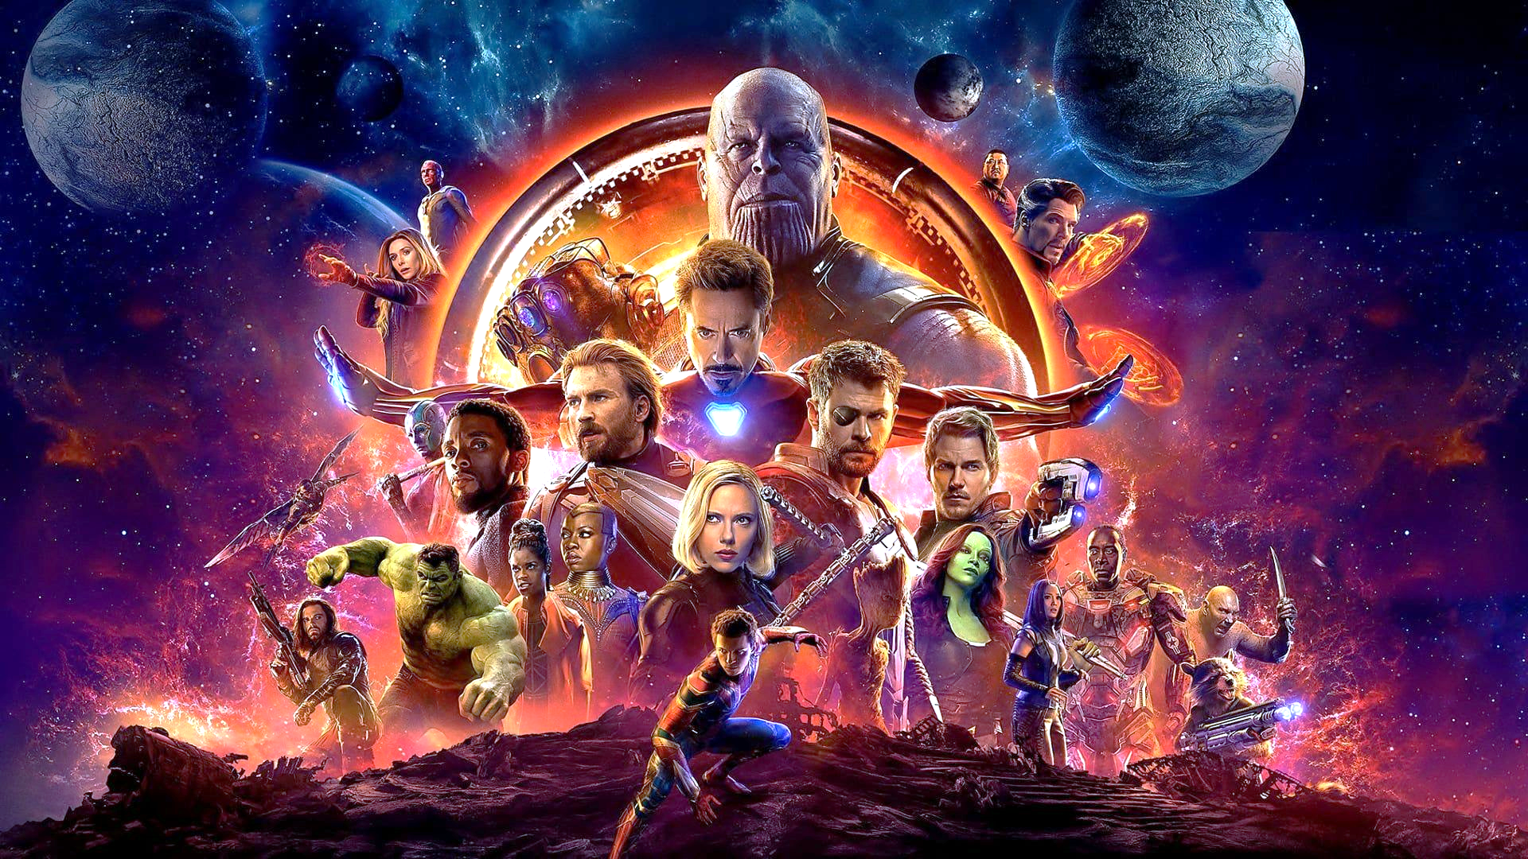
Avengers: Phase 3 quiz
Made by Jan James Lysnar 28/04/2019

Slide 2
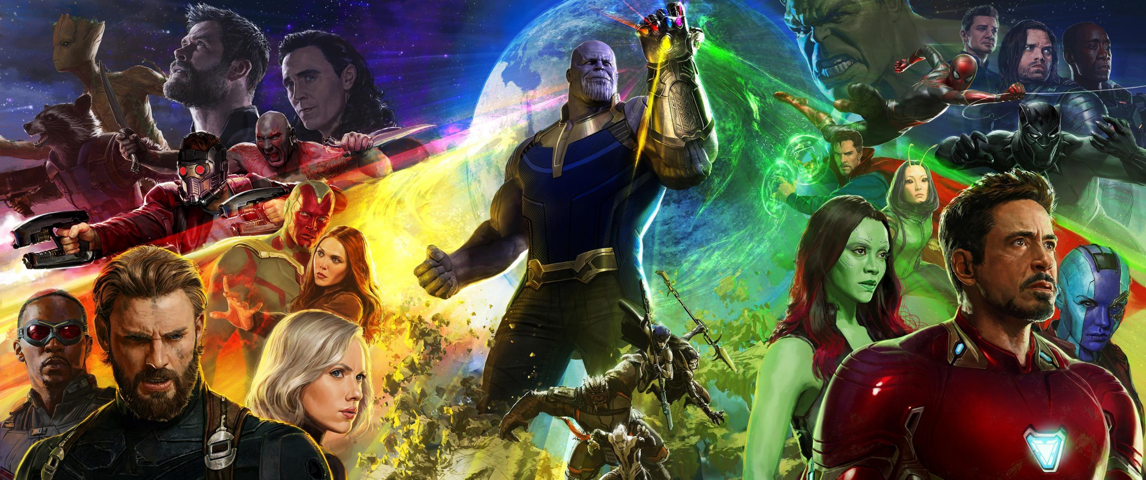

Welcome to the Quiz!
In this quiz you’ll be questioned from all the major story plot lines to the small little details in the movie! Do you have what it takes to complete all 50 questions correctly?

Slide 3

Question 1

Slide 4
Question 1
What was Thanos’s end goal in Infinity war?

